Slide 1
Analyzing the Task Prompt
What Task?

Slide 2
Why Analyze the Task Prompt?
Understand expectations
Guidance in production of final product
Keeps work on track
Encourage on task behavior
Novice writers

Slide 3
The Essential Question
The essential question guides the prompt and draws in the reader!
Draws interest
Should be intriguing
Answerable through the final product
Requires research or understanding of the required texts

Slide 4
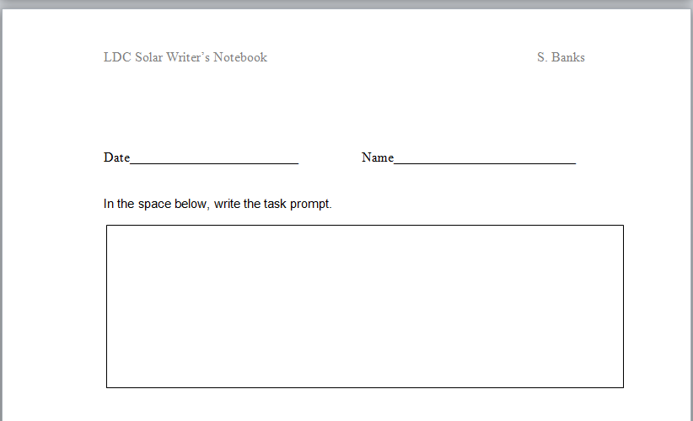
Teaching the Prompt
Allows students to get involved with the task prompt
Gets the students intimately involved with the prompt-knows it backwards and forwards
Anxiety relief about the task
What the student sees:

Slide 5
Reacting to the Prompt
Students respond to prompt
Optimal time to address anxiety about prompt
Can see what students want to learn (useful in guiding instruction)
Open-ended assignment-no penalization for subjective views
Individual or cooperative learning assignment

Slide 6
Task Analysis
Kagan© Cooperative Learning strategy Round Table
One form per team
Form rotates around team
One question per student Accountability

Slide 7
Keep it Visible!
Task prompt prominently visible in the classroom.
Visual re-energizes students
Reminds teacher to align instruction with standards

