Slide 1
Engaging Students in Classroom Conversations

Slide 2
Why give students the opportunity to engage in discourse?
“The CCSS emphasize that listeners should learn to take the stance of evaluator toward the speakers they encounter in school, examining points of view, reasoning, and rhetoric.” Lucy Calkins and Mary Ehrenworth Pathways to the Common Core
“Discussion is the perfect preparation for writing.” Mike Schmoker Focus
“To achieve a deeper understanding about the ideas and values in a text.” National Paideia Center

Slide 3
What is the occasion for discussion?
During a reading lesson, before formative writing assessment and/or when transitioning from Reading cluster to Writing Cluster
Partner Conversations
Group Work
Socratic Seminar
Engage students in a series of scaffolded questions and/or conversation prompts to support students’ understanding of complex text.

Slide 4
Considerations for partner conversations
Provide open-ended prompts/questions
Model ‘how tos’
Limit amount of time
Practice Speaking and Listening Standards

Slide 5
Considerations for group work
Provide open-ended tasks
Discuss roles, responsibilities and time limits
Model ‘how tos’
Practice Speaking and Listening Standards

Slide 6
Socratic Seminar
Students prepare ahead of time
Students respond to three types of questions prepared by the teacher
Text-based, literal or opening (1-2)
Text, Analysis or Core (1-2)
Beyond Text, Evaluative, or Closing (1-2)
Teacher facilitates conversation but does not participate

Slide 7
Socratic Seminar – Transitioning to Writing Skills Cluster
Classroom Structure
One large circle
Preparation
Draft questions
Decide on a moderator
Identify strategies and structures for student
accountability

Slide 8
Fishbowl Socratic Seminar – Transitioning to Writing Skills Cluster
Classroom Structure
Two concentric circles – one smaller inner circle
one larger outer circle
Preparation
Draft questions
Group students
Decide on a moderator
Identify strategies and structures for student
accountability

Slide 9
Conducting a Socratic Seminar
Students take pre-assigned places with their
responses to preplanned questions
Teacher reminds students of goals, expectations,
and accountability process
Teacher opens with a question
Students respond in a conversational format
Teacher may restate the opening question, ask
additional questions or move onto next preplanned
question

Slide 10
Example Socratic Seminar Questions—Science
What is the most important bone in the body? Why?
What are the skeleton’s functions?
How many different kinds of joints can you find? Describe them.
What similarities and differences do you notice between the upper and lower limbs?
Why might they be similar?
Why might they be different?
What else would you like to learn about the skeleton, bones or joints?

Slide 11
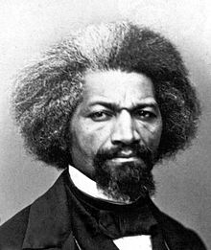
Example Socratic Seminar Questions—History
Based on the text, what adjective would you use to describe Frederick Douglass? Why?
Based on the text, why do you think Douglass wanted to write so badly?
As a slave and later as a freed man, Douglass was not taught to write. Do you think this made him more or less determined to learn? Why?
What do the strategies he used to learn have in common?
What do you think having the ability to write did for Douglass?

Slide 12
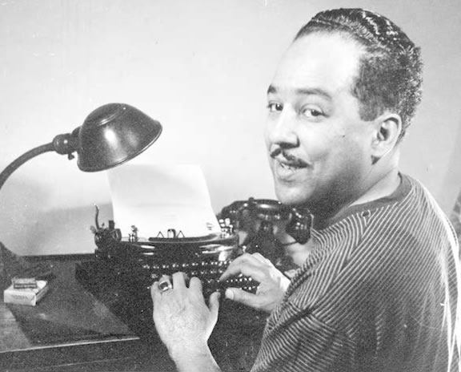
Example Socratic Seminar Questions—English
What do you think the speaker would say is the most important word or phrase in this poem? Why?
How does the speaker feel about the assignment he’s been given?
What does line 32, “That’s American,” mean?
Does the speaker undergo a change during the course of the poem? Explain.
In what ways does the speaker of this poem share the condition of ______________ from the novel, ____________?

Slide 13
Example Black Board
Expectations
- Always cite the text when making an argument
- When disagreeing with another’s conclusions, argument or solutions, briefly state what they said, don’t interrupt, and be civil and respectful
- Be concise and stay on point
- Avoid distracting verbal tics (“um,” “like,” “you know”)
- Texts to Consider
-Theme for English B by Langston Hughes
-The Color of Water by James McBRide
-Race by Elizabeth Alexander
- HOT WORDS
-Society, paradigm, paradigmatic shift, individual, race, identity, societal pressure, stereotype, “the other”
- Class Goal
-Track the speaker

Slide 14
Socratic Seminar in Small Groups – Reading Cluster
Teacher preplans a set of questions
Students read, discuss the meaning of text
and answer questions in small groups
At midpoint, one member from each group
meet in the center of the
circle to discuss a question

Slide 15
“If you never ask yourself any questions about the meaning of a passage, you cannot expect the book to give you any insight you do not already possess.”
—Mortimer Adler
Socratic Group Work
Fishbowl Socratic Seminar

