Slide 1
Using the Lab Report Template Task 17
Science Education

Slide 2
Science and LDC
Standards embedded in literacy strand
Lab reports more familiar to science teachers than essays
Still room for literacy skill development
Enhance inquiry based learning

Slide 3
Structuring the Module
Writer’s Notebooks
Organized Work
Lab report=informational writing with sci. method
Background information
Bridging skills crucial
Task engagement still very important
Module can span weeks of instruction

Slide 4
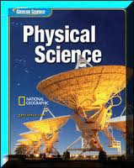
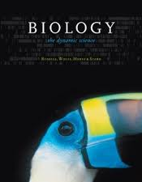
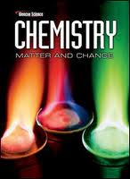
Structuring the Module
Part One: Background Info.
Relevant content info.
Variety of methods
Web quests
Worksheets
Notes pages for discussions & short lectures
May be presented after experiment for inquiry lessons

Slide 5
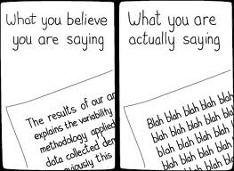
Structuring the Module
Transitioning to Writing
Bridging activities
Anticipated structure of report
Report template
Discuss style and formatting
Group reports-space for idea collaboration
If you don’t provide a structure, then students will invent one!

Slide 6
Bridge to Writing
Template task
Background Info.
Experiment
Bridge to writing skills needed!
Formal Lab Report

Slide 7
The Formal Lab Report
Make it Look Professional
Guide Your Students!
Analogous to research publication
Not just for honors
APA or MLA format encourages structure (teacher choice)
Provide template

Slide 8
Parts of a Formal Lab Report
Title page
Abstract
Intro
Method
Results
Conclusion

Slide 9
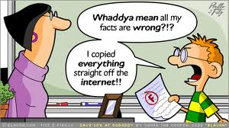
Academic Integrity
Plagiarism=Illegal
Not funny in real life!
Stress importance of citations
Even scientists “borrow” or add to research of others
Keep it legal!
References inclusive of websites-students forget
http://owl.english.purdue.edu/owl/section/2/

Slide 10
Incorporating Technology
Web
Quests
Lab
Equipment
Online
Databases
Video

Slide 11
Summary
Produce higher levels of reading and writing
Incorporate literacy into science classrooms
Meets Common Core State Standards
Addresses the instructional shift required of CCSS

