Slide 1
Teaching Task: Section 1 Training Suggestions

Slide 2
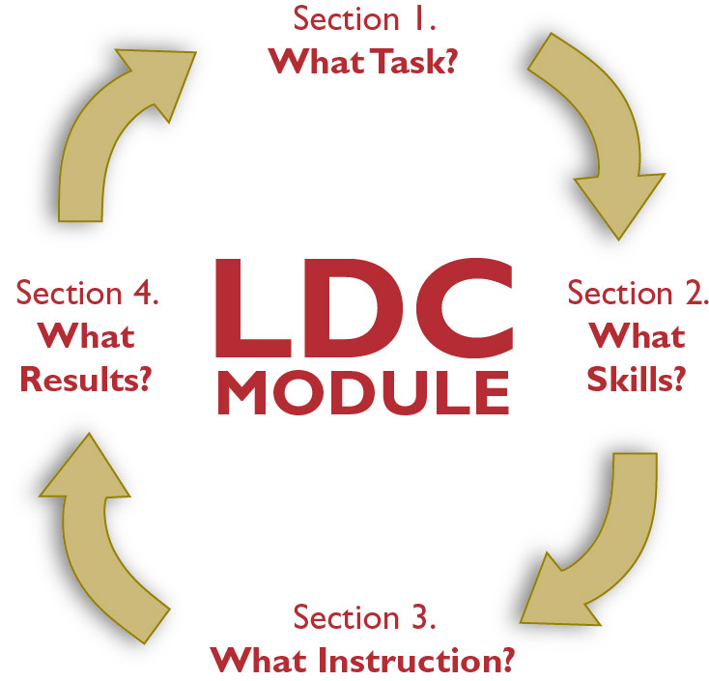
Teaching Tasks
Why the emphasis on tasks?
“What was different in the four classrooms was what students were actually being asked to do, and the degree to which the teacher was able to engage students in the work by scaffolding their learning up to the complexity of the task she was asking them to do.”
– Richard Elmore
Rounds in Education. lEizabeth A. City, Richard F. Elmore, Sarah E. Fiarman, and Lee Teitel

Slide 3
Building High Quality Teaching Tasks from Templates
- Provided by Kentucky

Slide 4
Jurying Sample Teaching Tasks
Strong Teaching Tasks…
Are worthy of 2, 3 or 4 weeks of instruction;
Ask students to grapple with an important issue;
Provide opportunities to address text complexity and the use of informational text as called for in the CCSS;
Have students working in the most effective mode of discourse/text structure;
Evolve from a rigorous text-dependent question;
Provide an authentic audience.
*See Sample Teaching Tasks
- Provided by Reach Associates

Slide 5
Creating a Teaching Task and Providing Feedback
Facilitator provides a topic
Participants work in pairs to write a teaching task pertaining to the topic
Partners pass teaching task to a different pair
Partners offer written feedback
- Provided by Reach Associates

Slide 6
Deconstructing a Teaching Task
*See Deconstructing Teaching Task
- Provided by Reach Associates

Slide 7
More to come…

