Slide 1
Writing a Thesis Statement / Claim for Argumentation Writing Mini-Task
Skill Cluster: Writing Process

Slide 2
Thesis Statement
Students will be able to identify the characteristics of a thesis statement. Students will develop a claim, or argument, within their thesis statement. Students will receive peer feedback on their argumentative claim and thesis statement.

Slide 3
Instructional Ladder
Pacing | Skill/Definition | Product/Prompt | Scoring | Instructional Strategies
1 class period (55 min) | Thesis Statement: Ability to establish a claim. | Write a formal thesis in your Writer’s Notebook using your quick-writes, notes, and article information to ensure a strong claim. | Writes a thesis that establishes a controlling idea and identifies key points that support development | In pairs, students will edit sample thesis statements provided by the teacher. As a class, go over each thesis statement, identifying the strong and weak characteristics of each statement. After editing the sample thesis statements, review qualities of a strong thesis as a class: must be an argument, include simple defense of the argument, and include categories to lead reader and organize essay. Make a class list of these qualities. Peer Review – Students will use sticky notes to provide feedback on each other’s statements
3

Slide 4
Preparing Materials
Create a handout that includes 4 - 5 sample thesis statements of varying levels. Leave space below each statement for students to take notes.
* This activity works best when using sample thesis statements for a different topic than the current one students are working with.
4

Slide 5
Introducing the Mini-Task
In the form of an opening question or journal activity, ask a question that will engage students in a conversation about claim or thesis statements. For example…
What is a thesis statement? Why do authors include a thesis statement / claim? What makes a thesis statement “good”?
5

Slide 6
Editing Sample Thesis Statements
Ask students to find a partner. Provide each pair with a set of sample claim statements
In pairs, students will make a t-chart below each sample thesis statement identifying its strengths and weaknesses.
6

Slide 7
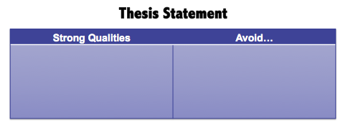
Class Discussion
When pairs are finished editing the thesis statements, project each statement on the board and discuss the edits as a class.
Generate a class list of characteristics of a strong thesis statement.
7

Slide 8
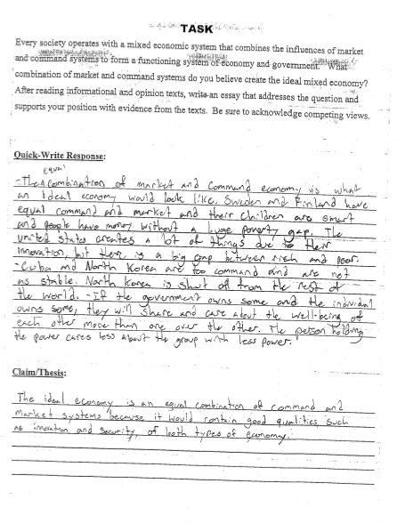
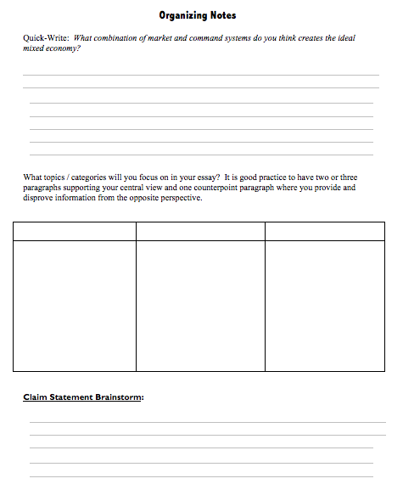
Independent Work – Writing the Thesis
It is helpful for students to write their claim in the same place they did their initial thinking or brainstorming for the task.
Two Writer’s Notebook Examples:
8

Slide 9
Peer Review
This simple peer review activity is an efficient way to ensure that each student receives feedback in a safe and supportive environment.
Students will use sticky notes to provide
each other feedback on their thesis
statements using the following guiding
questions:
Does the author have a clear controlling idea?
What are the strengths of the the overall thesis statement?
Are there any characteristics that need improvement?
How can the author make their controlling idea more complex?
Does the wording of the statement “flow” well?
9

Slide 10
Results
Students will have feedback on their thesis statement and be prepared to write a final draft.
Students should also be made aware that adjustments to the thesis statement can be made throughout the writing process.
10

