Slide 1
Deconstructing the Rubric Mini-Task
Click for sound
Skill Cluster: Preparing for the Task

Slide 2
Why Deconstruct the Rubric?
Click for sound
Students will gain a deeper understanding of expectations for the task and final product. Students will take “ownership” of the rubric. Students will work together to initiate conversation about characteristics of strong writing.

Slide 3
Instructional Ladder
Click for sound
Pacing | Skill/Definition | Product/Prompt | Scoring | Instructional Strategies
1 class period (55 min) | Ability to deconstruct the rubric into meaningful language and examples. | In small groups, translate your assigned rubric category into your own words and provide examples. Take notes on all rubric categories from posters created by other groups. | Students have a completed “Rubric Translation” sheet in Writer’s Notebook. | Jigsaw/Gallery Walk: Divide class into small, diverse skill-level groups of 3-4 students. Assign each group of students a rubric category. Model the first category as a class. Ask students to write translation on a poster. When students have translated the rubric, they will do a gallery walk around the room to take notes on the other rubric category posters.

Slide 4
Introducing the Mini-Task
Click for sound
In the form of an opening question or journal activity, ask a question that will engage students in a conversation about rubrics. For example…
What experience do you have with rubrics? What is the purpose of a rubric? How can rubrics help you?
4

Slide 5
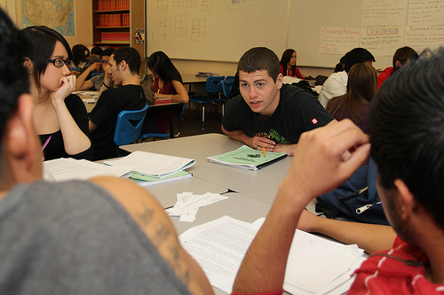
Assign Small Groups
Click for sound
Organize students into small groups of 3 - 4. Assign each group a rubric category (some groups might get the same category).
Ensure the groups have diverse skill-levels to better support learning for all students.
Discuss group “norms”: How will you all contribute equally? (possibly assign individual roles)
5

Slide 6
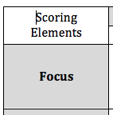
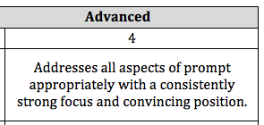
Model the Mini-Task
Click for sound
Show students the first LDC category: Focus.
Guide students in a class discussion to translate the rubric into meaningful language and examples.
Have students record the whole-class generated translation in their blank rubric handout.
6

Slide 7
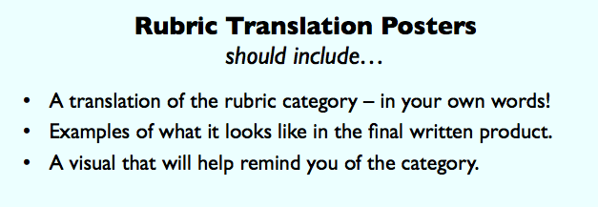
Rubric Translation Posters
Click for sound
Groups will translate their assigned rubric category and create a poster to present their translation.
Post guiding questions on the overhead or write on whiteboard to keep students focused on the goals.
7

Slide 8
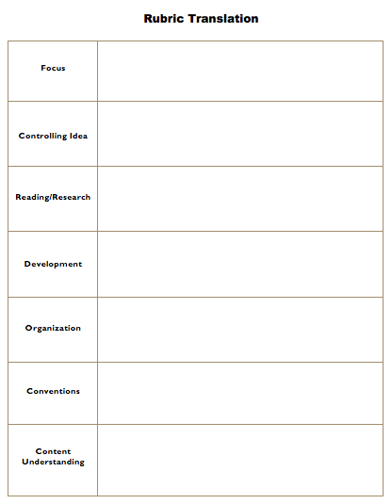
Gallery Walk
Click for sound
When students have completed their posters, place them around the classroom. Then, have students do a gallery walk to record notes from the other posters on their Rubric Translation Sheet.
8

Slide 9
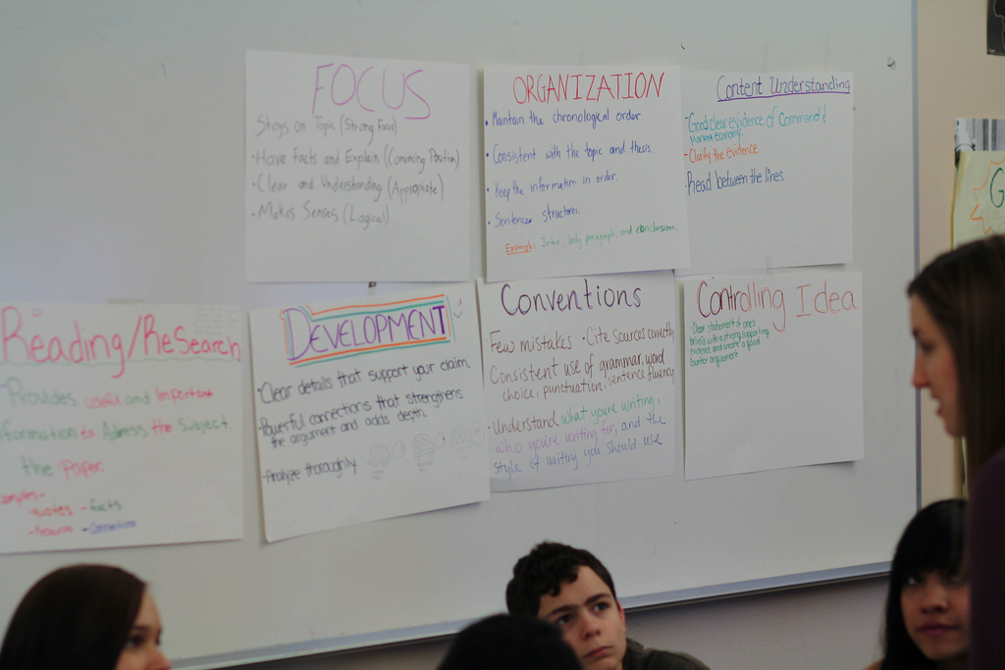
Results
Click for sound
After notes have been recorded, choose the best posters to place somewhere highly visible in the classroom to keep students focused on the expectations of the task.
9

